Slide 1
MRSA
Understanding Methicillin Resistant staph aureus for Environmental Services Personnel

Slide 2
What is MRSA?
Methicillin resistant staphylococcus aureus
  staphylococcus aureus = a bacteria commonly referred to as “staph”. It is the cause of most skin infections.
  Methicillin resistant = not killed by common antibiotics used to treat staph bacterial infections

Slide 3
MRSA, MRSA, MRSA
MRSA has been making headlines all over the country
MRSA has been a serious concern in hospital-based institutions for years
MRSA infections occurring outside of the hospital (community acquired) are becoming more common and create a health concern for everyone

Slide 4
MRSA Facts
Many people (25-35%) are carriers of MRSA on their skin and/or in their noses and do not have any symptoms
Most healthy people recover from MRSA with antibiotic treatment
MRSA can cause life threatening infections in people with weakened immune systems
MRSA can survive many extreme environmental conditions for 7 days to 7 months

Slide 5
MRSA on Campus
5 Cs : Crowding, frequent skin-to-skin Contact, Compromised skin (cut, scrape, or rash), Contaminated items and surfaces, and lack of Cleanliness
Typical college population believes they are “invincible” and do not wash hands enough increasing the risk of spreading infections
MRSA is commonly found in dormitories, rooms/waiting areas of health clinics, athletic/wellness areas, and locker rooms

Slide 6
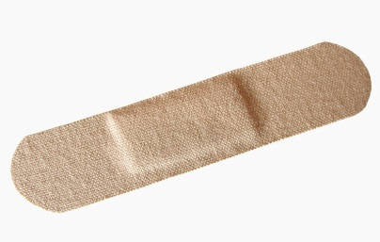
How do people get it?
Touching infected skin (skin to skin contact)
A person with MRSA touches their wound or wound drainage and does not wash their hands effectively
Sharing items such as towels, washcloths, razors, and clothing
Contact with objects and surfaces that have MRSA wound drainage or bacteria on them
  For example: door handles, weight benches, towels, dirty dressings such as band aids, faucets, whirlpools, showers, chair arms, and countertops.

Slide 7
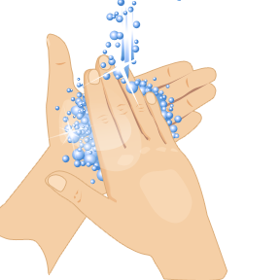
How Do We Get Rid of It?
You can not eradicate MRSA; you can only control it
HAND WASHING = best prevention of the spread of MRSA
Important to keep open wounds covered
Avoid sharing personal items
Report any wound, pimple, or boil that does not heal, is getting worse, or is accompanied by a fever

Slide 8
UNI Specifics
Building services has a process in place to activate when they are aware that there is a known MRSA or staph infection
This includes a call tree to involve all staff members and departments affected by the infection
4 cleaning products have been identified for use in controlling MRSA infections and products are rotated on a monthly basis to assure that the infection does not become resistant to any certain product

Slide 9
Custodial staff will disinfect every surface that could be contaminated within the involved facility every night for one week
It is REQUIRED that anyone aware of persons with a staph infection on campus report it immediately to Dennis Hayes at 3-7653 or 319-290-6196

Slide 10
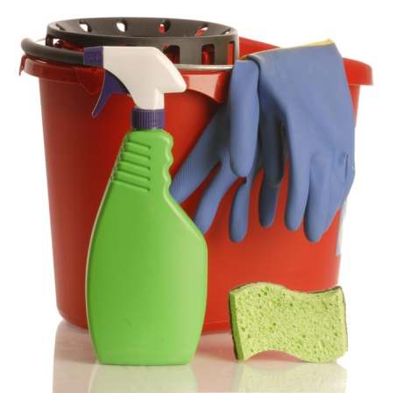
How do I safely and effectively clean up blood and body fluid spills?
Wash hands and put on gloves
If splashing is a possibility, wear a face shield and gown
Apply disinfecting solution to spill according to manufactures instructions
Keep area wet with solution per
directions on product bottle

Slide 11
Blot up spill with disposable towels and dispose of towels in plastic lined waste receptacle
Wipe dry with a dry disposable towel and discard as above
Remove gloves and dispose of them in a plastic lined waste receptacle
WASH hands

Slide 12
Clean Up Hints
Clean and disinfect surfaces that are likely to come into contact with uncovered or poorly covered infections
Routine cleaning and disinfecting of commonly used areas and frequently touched surfaces.
It is critical that detergent-based cleaners and disinfectants are used safely, appropriately, and according to instructions

Slide 13
Pay special attention to contact times
Contact time = time surface must be kept wet with cleaner
Do not over use wipes
Clean visible soil before using disinfecting agent
Launder items that could come into contact with infectious material such as uniforms
Change mop water frequently and before leaving in high risk areas such as showers

Slide 14
Areas of Concentration
Weight benches should be wiped down with appropriate cleaner
Students should be encouraged to use a barrier to bare skin such as T-shirt or towel, while using exercise equipment
Bathroom facilities, especially showers floors, should be cleaned regularly with EPA-registered disinfectant

Slide 15

Laundry should be washed regularly with detergent and hot water, and dried thoroughly
Whirlpool turbines should be cleaned with bleach or ammonia by allowing solution to circulate through a running turbine with hot water for 10 minutes
Student education about hand washing and keeping wounds covered

Slide 16
Staff safety during clean up
Appropriate chemical – EPA registered to kill MRSA.
  Disinfectants can be irritating and associated with asthma or skin problems so it is important to use them safely.
Appropriate Personal Protective Equipment
More is not necessarily better – only enough solution to keep surface wet for recommended amount of time
Universal precautions – hand washing, before and after clean up

Slide 17
Which disinfectant should I use for MRSA?
Use EPA registered disinfectant
  http://www.epa.gov/oppad001/chemregindex.htm
  Read the product label first for important facts such as:
    How long to apply the product to the surface
    How long you need to leave it on the surface to be effective (contact time)

Slide 18
    If the surface needs to be cleaned first and rinsed after using
    If the disinfectant is safe for the surface
    Whether the product requires dilution with water before use
    Precautions you should take when applying the product, such as wearing gloves or aprons, or making sure you have good ventilation during application

Slide 19
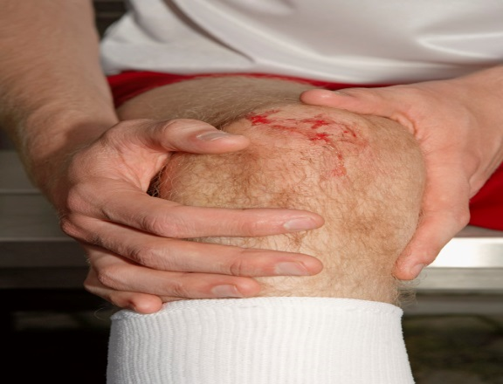
What do I do if I think I have MRSA?
Cover the affected area
See your doctor
Let your supervisor know
You can still work!
Don’t share personal items with others
WASH YOUR HANDS often

