Slide 1
UNI Campus Master Plan
Presentation to the Board of Regents
November 9, 2022
Mike Zwanziger, Assistant Vice President & Director of Facilities Management

Slide 2
Introduction
Planning Process
Master Plan Vision, Goals and Objectives
The Existing Campus
Renew, Reinvest and Right-Size
Auxiliary Enterprises

Slide 3
Planning Process
UNI has an ongoing planning process where buildings and programs are continuously evaluated.
Space Audit/ Needs Analysis
Space planning
Academic alignment
Program test fits
Facilities assessments to identify maintenance needs
Outcomes
Campus Master Plan
Micro-master plans
Academic Strategic Plan
Departmental program assessments
Building space assessments
Site development plans
Transportation plan
Infrastructure Master Plan

Slide 4
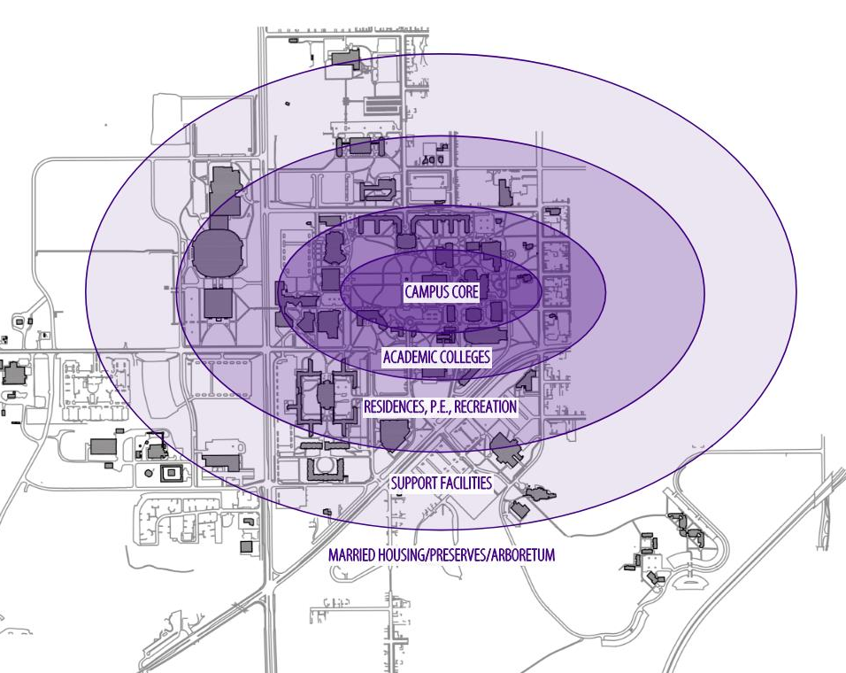

Guiding Principles
Concept of Concentric Zones from 1968 Campus Master Plan
Created a very walkable campus
Heart of campus centered on the Campanile, Library and Union
We shape our buildings; thereafter they shape us.
Winston Churchill
Notes:
[INSERT MIKE’s TALKING POINTS HERE]
Backup Information:
Provided the basis for expansion and to provide systematic development as the campus grew with the change from ISTC to UNI
The core would contain the most intense and universally used facilities
The concept provided for orderly, systematic development and staging of facilities.

Slide 5
Master Plan Vision, Goals and Objectives
Vision:
The University of Northern Iowa will continue to reinvest in, renew and right-size its facilities in support of the institution’s academic and co-curricular mission, leveraging its resources for the benefit of the citizens of the state of Iowa.
Reinvest In Infrastructure: Continue to make annual investments to maintain existing facilities and infrastructure
Renew Program Space: Update and adapt critical campus space in support of academic programming objectives
Right-Size Campus: Assess underutilized and obsolete space, while continuing to improve overall space utilization.

Slide 6
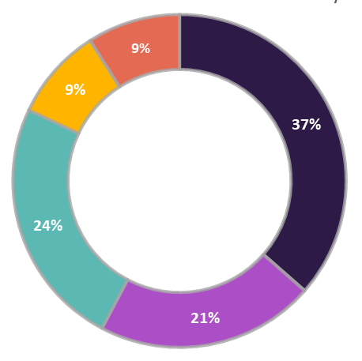
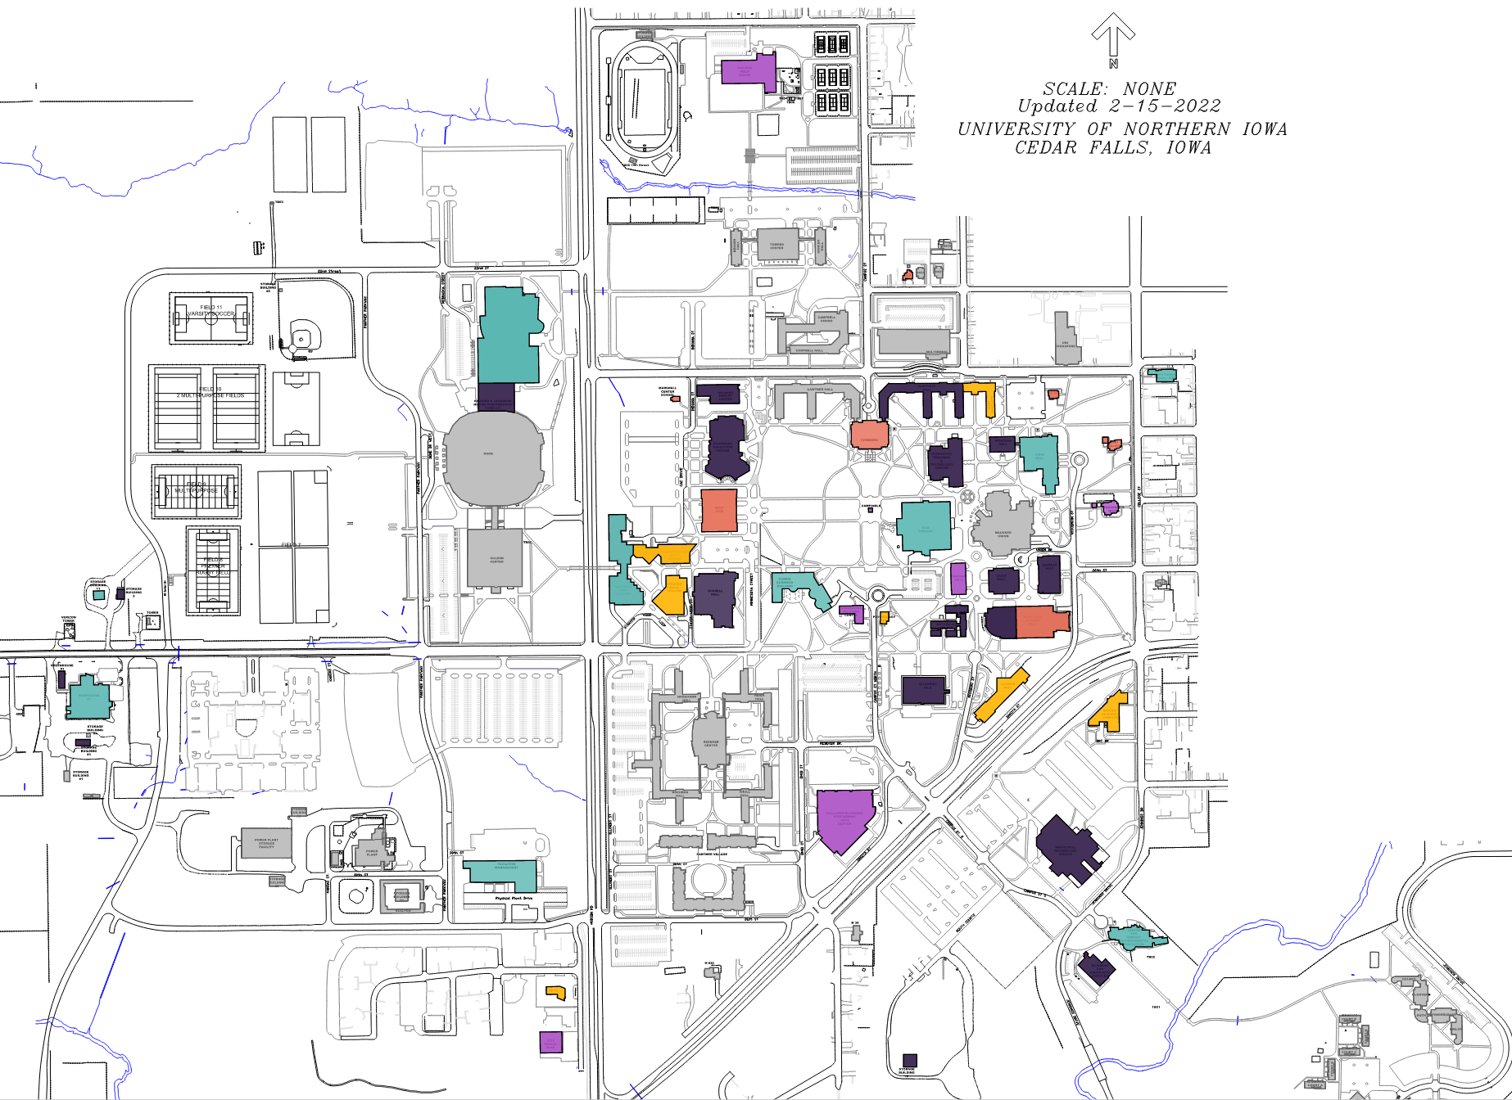
Facility Condition Analysis - GEF
Campus St
Hudson Road
W 23rd St
Sustainment
System repairs
System replacements
Multiple system replacements
Extensive system replacements
College St
W 27th St
University Avenue

Slide 7
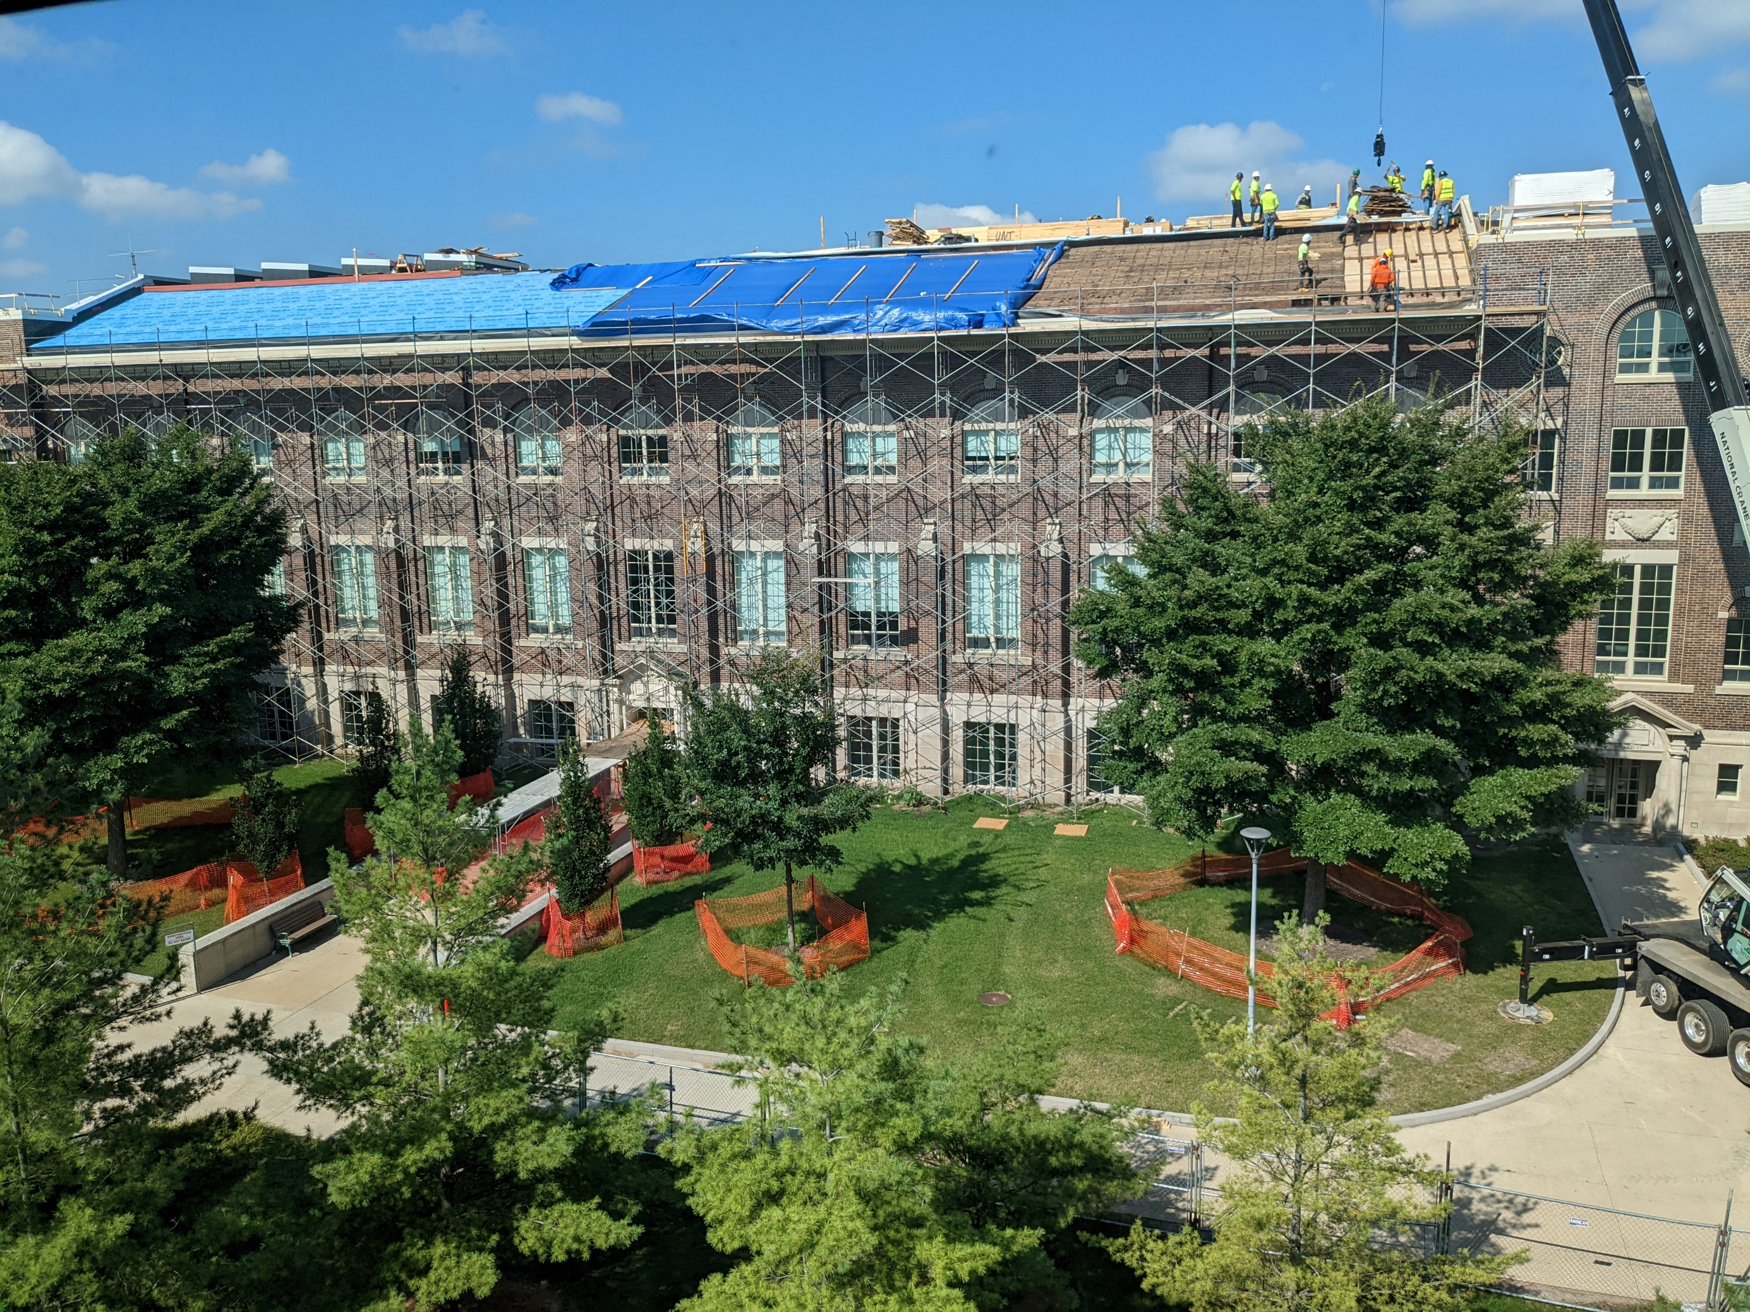
Reinvest in Infrastructure
Types of projects include:
HVAC updates
ADA accommodations
Building envelope improvements
Fire alarms
Elevator upgrades
Roofing replacement
ITTC new roof creates opportunities for program development

Slide 8
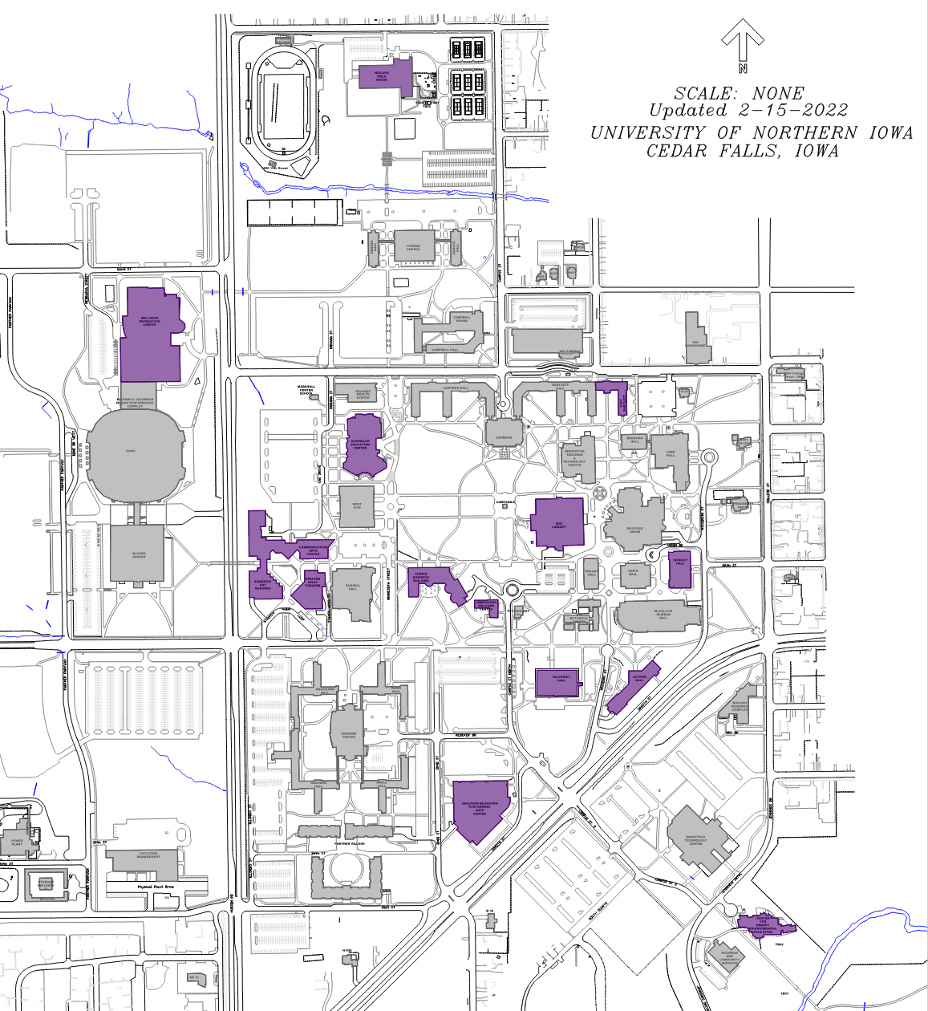
Reinvest in Infrastructure
Major Maintenance Capital Request
$6 million/year for five years
Impacts 15 GEF Buildings
50% of campus GEF space
Buildings contain
68 general purpose classrooms
41 teaching laboratories

Slide 9
Reinvest in Infrastructure
Building Scope Estimate Programs Impacted
Roof Replacement
Window Replacement
Envelope Repairs
ADA Improvements
Roof Replacement
HVAC
Control Systems
Envelope Repairs
Roof Replacement
Sitework
HVAC
Control Systems
Admissions Welcome Center
Center for Energy and Environmental Education
Communication Arts Center
Curris Business Building
East Bartlett Hall
$200,000
$1,000,000
$5,550,000
$1,725,000
$2,000,000
Admissions
CEEE
AmeriCorps
Continuing Education
Communication Science
CHAS
Theatre
Accounting
Economics
Finance
Management
Academic Advising
Career Services
Iowa Math & Science Partnership

Slide 10
Reinvest in Infrastructure
Building Scope Estimate Programs Impacted
Gallagher Bluedorn Performing Arts Center
Gilchrist Hall
Kamerick Arts Building
Latham Hall
Nielsen Field House
Roof Replacement
Roof Replacement
ADA
Roof Replacement
Windows
HVAC
Envelope Repairs
Window Replacement
Roof Replacement
GBPAC
Music
Numerous student support programs and administration
Art
Applied Human Science
Earth & Environmental Sciences
Child Development
Military Science
$1,700,000
$950,000
$4,210,000
$1,500,000
$500,000

Slide 11
Reinvest in Infrastructure
Building Scope Estimate Programs Impacted
Roof Replacement
Roof Replacement
HVAC
Control Systems
HVAC
Control Systems
Roof Replacement
Roof Replacement
Rod Library
Schindler Education Center
Seerley Hall
Strayer Wood Theatre
Wellness Recreation Center
$2,500,000
$4,210,000
$975,000
$4,740,000
$700,000
Numerous library services
Numerous Education programs
University Administration
History
Theatre
Health, Recreation and Community Services
Kinesiology
Recreation Services
COE Student Advising

Slide 12
Renew Program Space
Meet the statutory mission as a comprehensive university
Strengthen the educational, social, cultural and economic development of Iowa
Conduct programs in the liberal and vocational arts and sciences
Address the impacts of Academic Positioning pathways
Health
Educator Preparation
Data science
Business
Applied Engineering
Maximize return on investment
Schindler Education Center (2017)
Applied Engineering Building (2024)

Slide 13
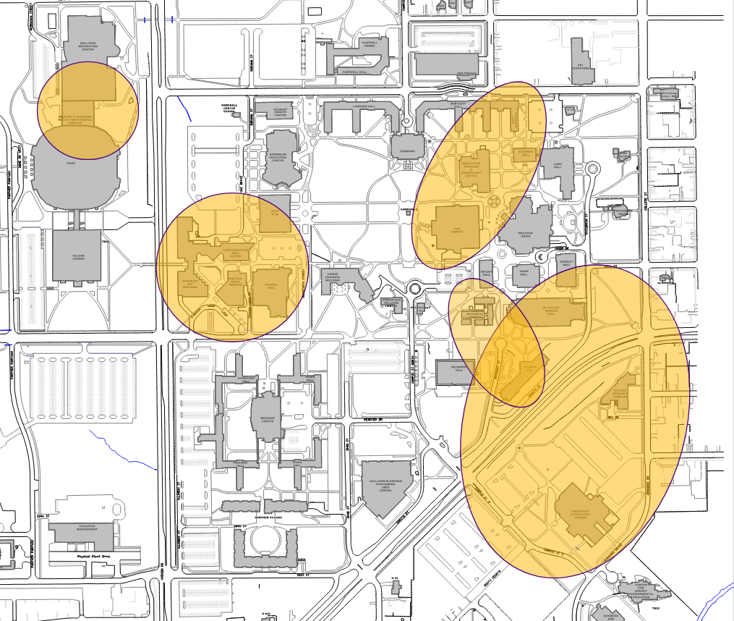
Renew Program Space
Responding to Academic Initiatives
Academic Positioning
Interdisciplinary
Responsive to changing program demands
Hubs are organized around
Health
Performing Arts
Data Sciences
STEM
Environment and Sustainability
Concept A

Slide 14
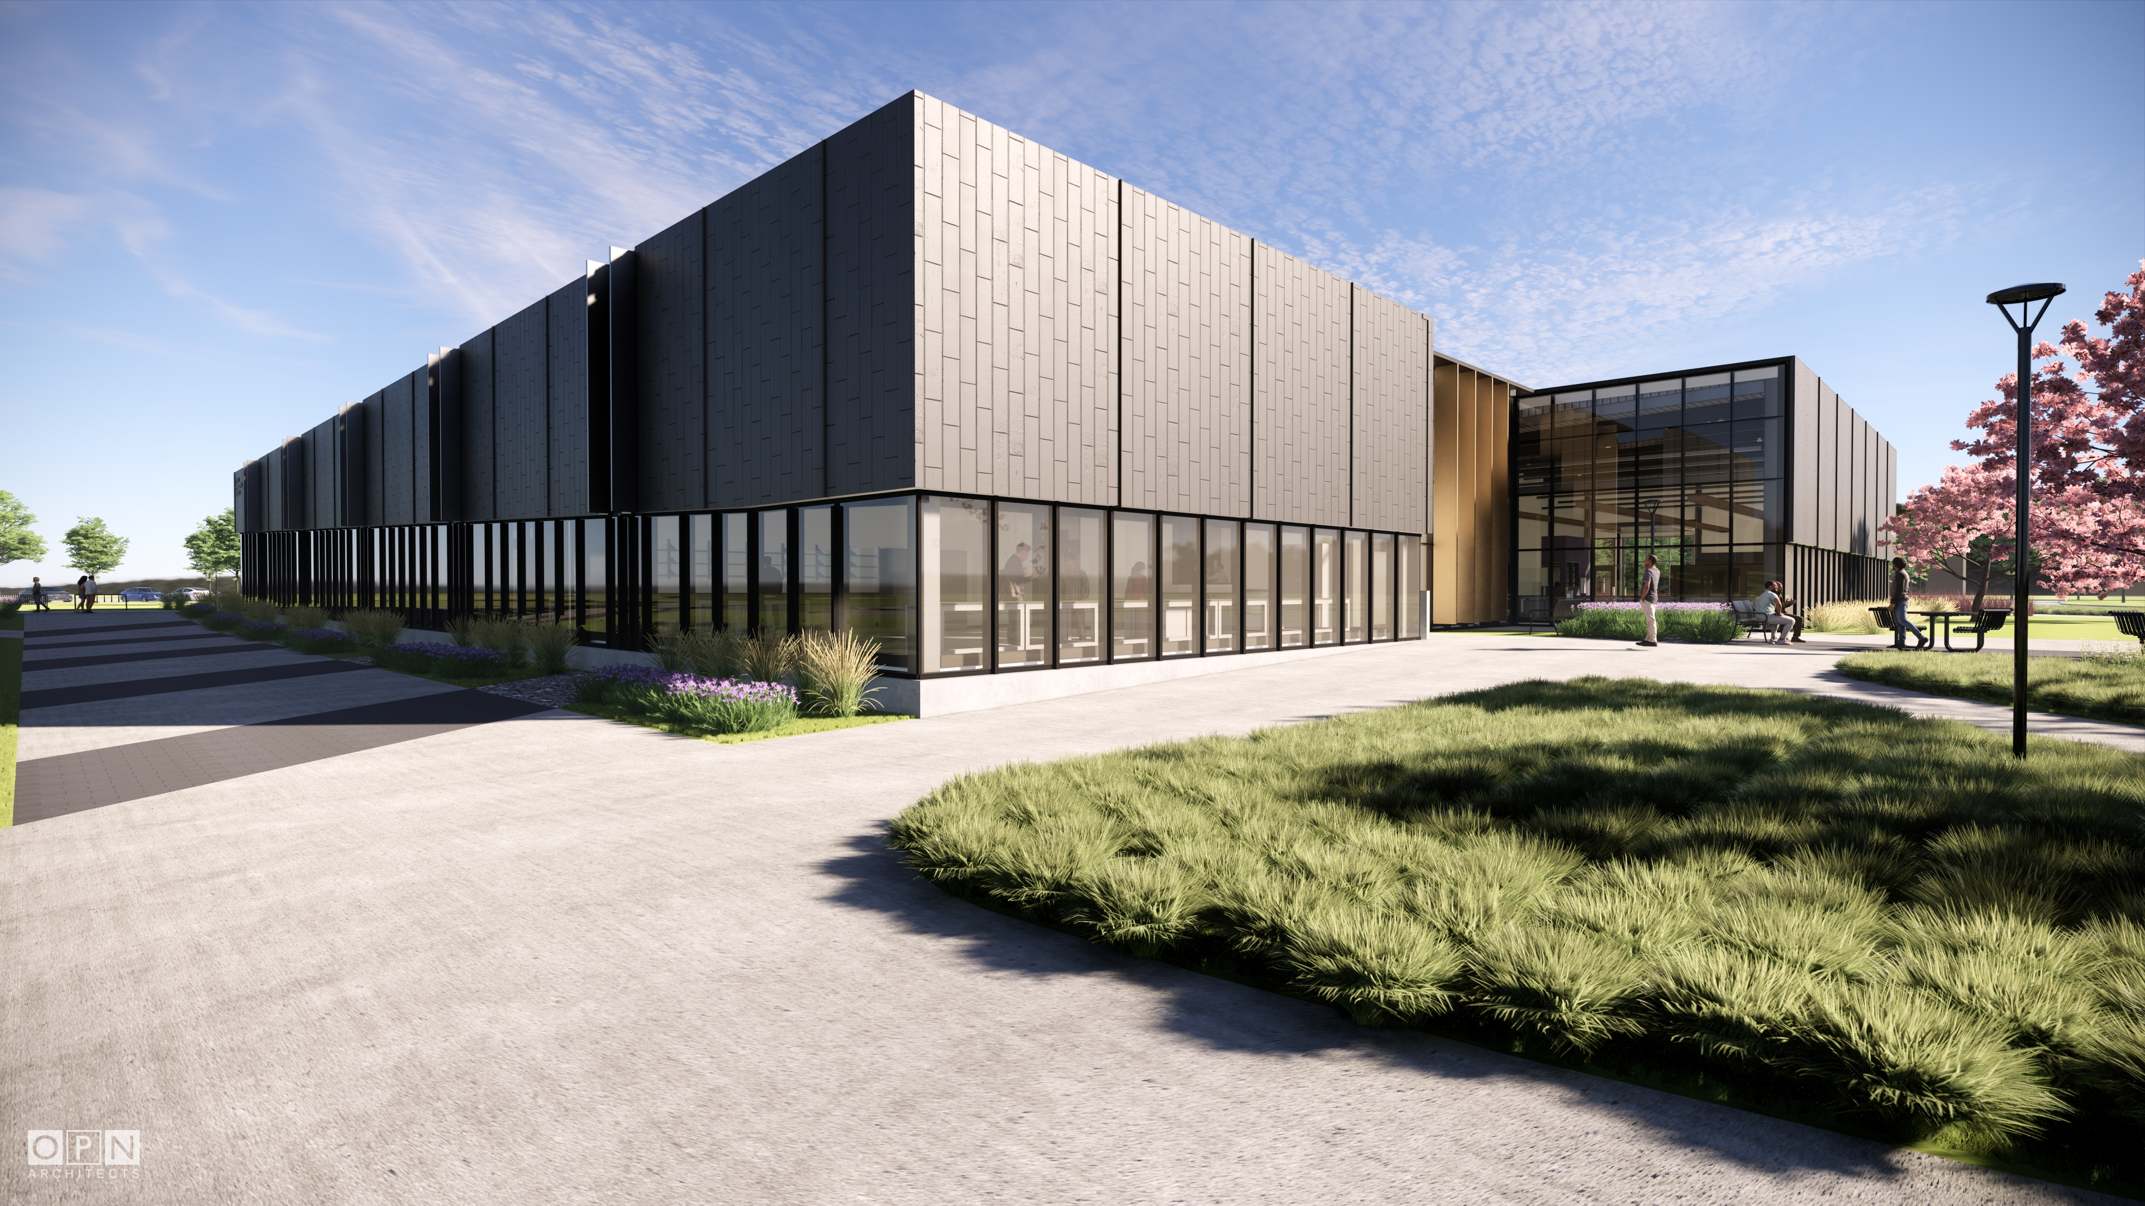
Right-Size Campus
Analyze individual buildings on an ongoing basis and consolidate underutilized spaces
Identify opportunities to advance programs through space efficiencies and improvements
Promote sharing of support spaces to minimize redundancy
Assess buildings that:
Require excessive facility renewal
Are functionally obsolete
Have significant code deficiencies
Recent Successes
Honors Program
International Programs
Applied Engineering Building

Slide 15
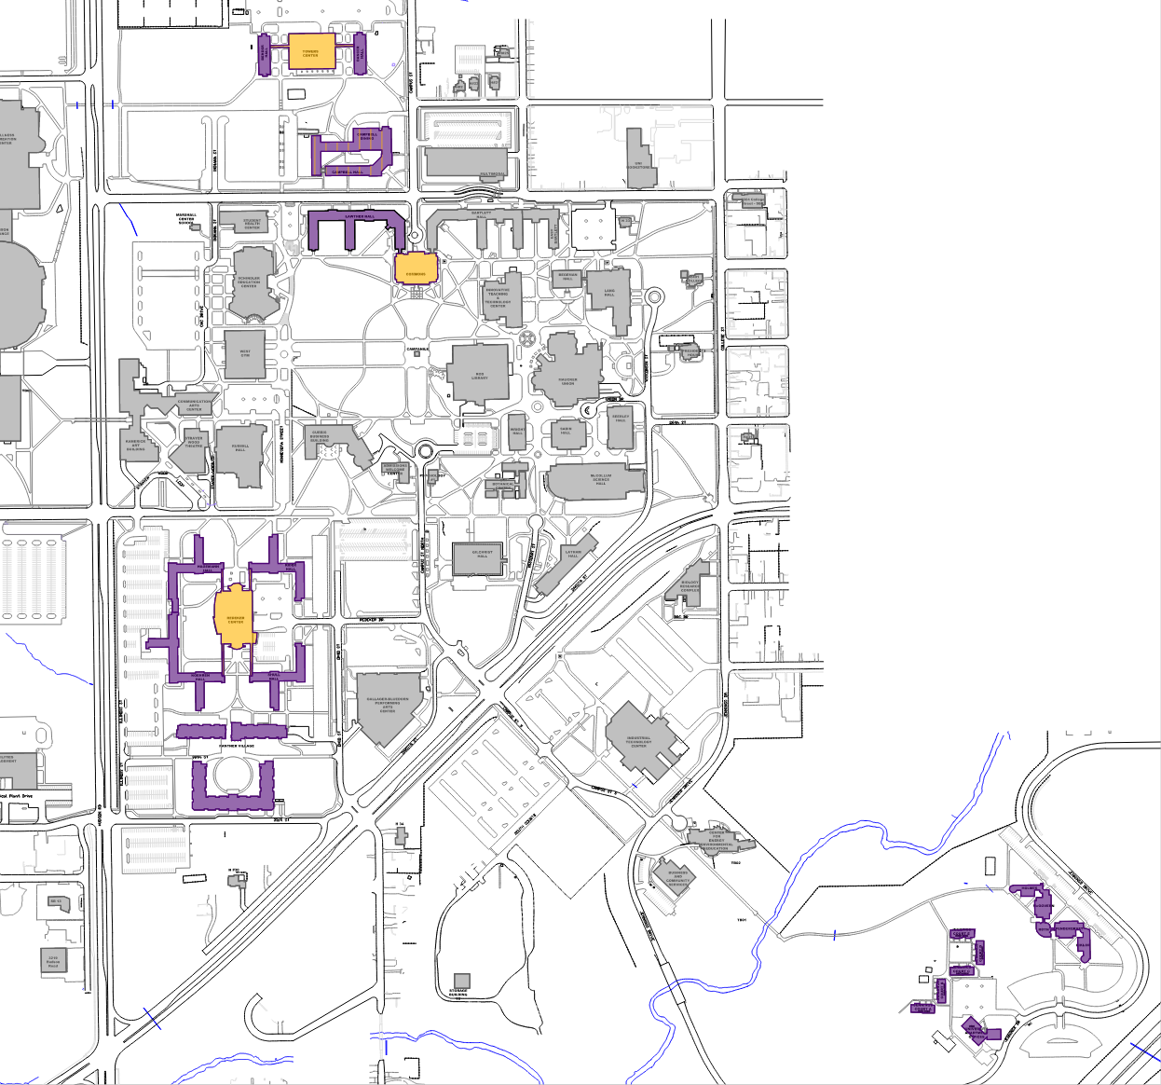
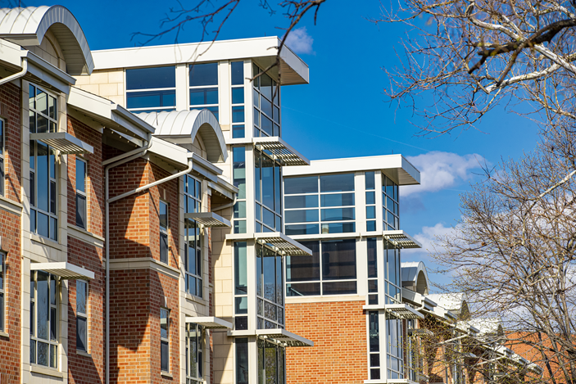
Housing
Housing inventory is primarily established for first and second year students, with an increasing number of transfer and upper-division returning students.
Housing Solutions
Continue to modernize housing to better serve student needs (Noehren)
Upgrade finishes and restrooms in select halls (Dancer)
Transition some housing toward suites and semi-suites (Lawther)
Provide more apartment based units (Panther Village)

Slide 16
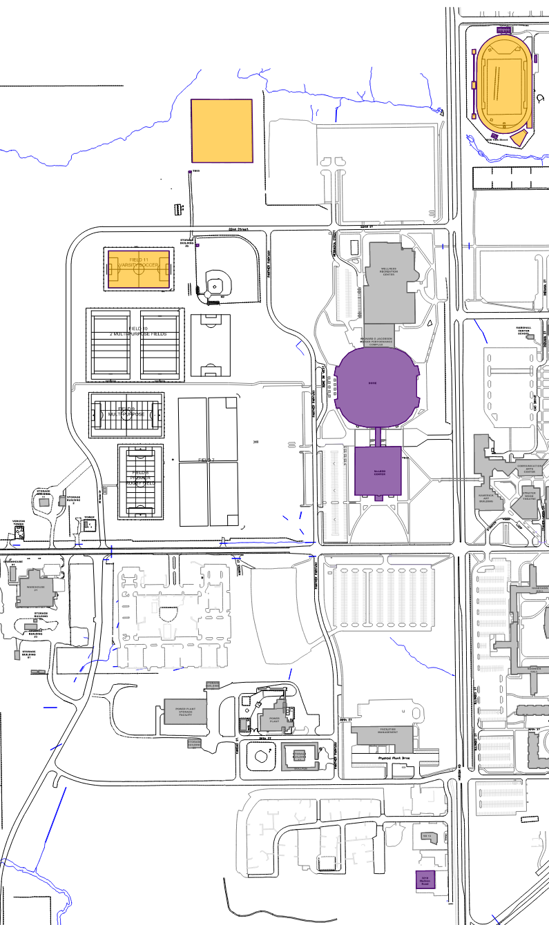
Athletics
Anticipated needs have been studied
Recently completed projects include:
Football Team Room
Football Practice Field
Soccer Field
UNI Dome fabric roof replacement is underway
Next focus is based on the Capital Campaign
Dome modernization
Track modernization
Update outdoor and indoor practice facilities

Slide 17
Summary
Academic Positioning effort is driving innovation at UNI
Cornerstone of this is to support Iowa’s workforce needs
UNI’s Campus Master Plan reflects these academic initiatives
Re-investing in infrastructure
Renewing program space
Right-sizing the campus
Continuous planning outcomes include new academic hubs that are shaping the campus of the future.
Campus auxiliaries are adapting to meet the needs of today’s students.

Slide 18
Questions
University of Northern Iowa
Campus Master Plan Update

